Slide 1

6th Grade Accelerated Math
Unit 5, Lesson 4 Exploring Tables of Equivalent Ratios Volume 1, pg. 188

Slide 2


Benchmarks
MA.6.AR.3.2
Given a real-world context, determine a rate for a ratio of quantities with different units. Calculate and interpret the corresponding unit rate.
MA.6.AR.3.3
Extend previous understanding of fractions and numerical patterns to generate or complete a two- or three-column table to display equivalent part-to-part ratios and part-to-part-to-whole ratios.
volume 1, pg. 188

Slide 3
Integrated Mathematical Thinking and Reasoning Standards
MA.K12.MTR.2.1 Demonstrate understanding by representing problems in multiple ways.
MA.K12.MTR.5.1 Use patterns and structure to help understand and connect mathematical concepts.
volume 1, pg. 188

Slide 4

Learning Target
I can build tables of equivalent ratios incorporating an understanding of unit rate.
volume 1, pg. 188

Slide 5

Warm-Up
volume 1, pg. 188

Slide 6
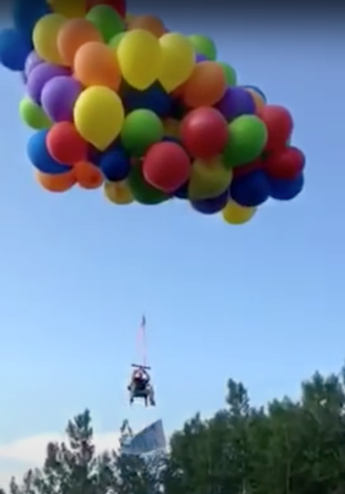
5.4.1 Warm-Up: Balloon Lift
In 2015, a Canadian man attached enough balloons to his lawn chair to float up into the sky.
Write a question, a wonder, or a comment about this scenario to be used during a class discussion.
volume 1, pg. 188

Slide 7

Exploration
volume 1, pg. 189

Slide 8

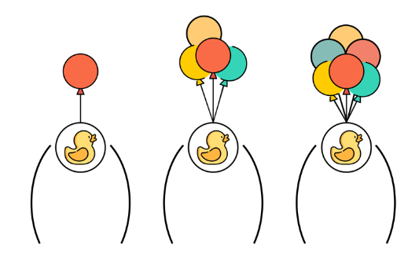

5.4.2 Exploration: Make It Float
Flying high with balloons is dangerous! This activity will focus on determining how many balloons it takes to float various objects.
The images below show different numbers of balloons attached to rubber ducks of equal weight. The first image shows the ducks before they are released from the hold. The second image shows what happens after they are released.
Before Release | After Release
volume 1, pg. 189

Slide 9
Write one thing you know, one thing you wonder, and one thing you learned after looking at the figures above.
One thing I know is …
One thing I wonder is …
One thing I learned is …
volume 1, pg. 189

Slide 10
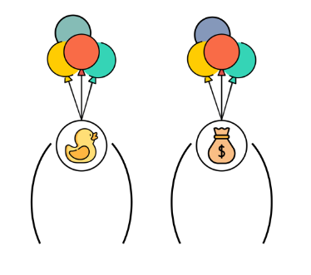
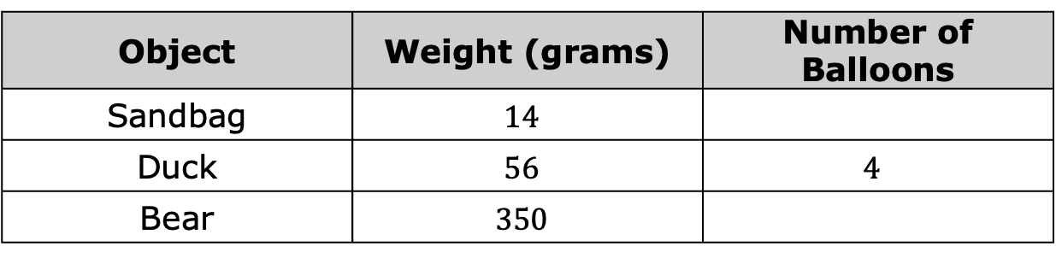
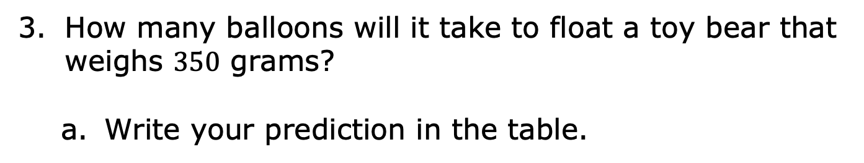
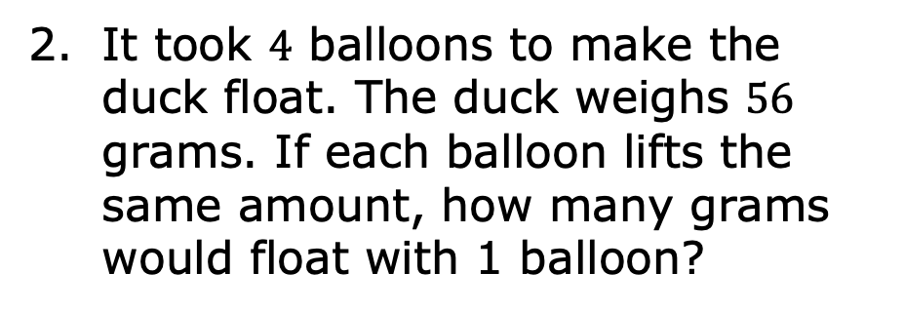
It took $4$ balloons to make the duck float. The duck weighs $56$ grams. If each balloon lifts the same amount, how many grams would float with 1 balloon?
How many balloons will it take to float a toy bear that weighs $350$ grams?
Write your prediction in the table.
Object | Weight (grams) | Number of Balloons
Sandbag | $$14$$
Duck | $$56$$ | $$4$$
Bear | $$350$$
volume 1, pg. 189

Slide 11
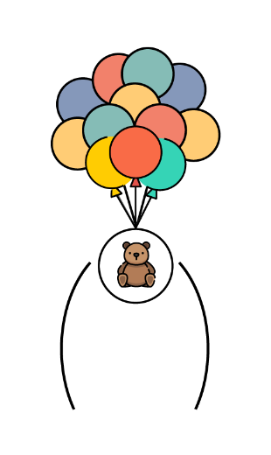
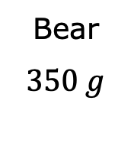
Explain the reasoning for your prediction.
Bear
$$350 g$$
volume 1, pg. 189

Slide 12
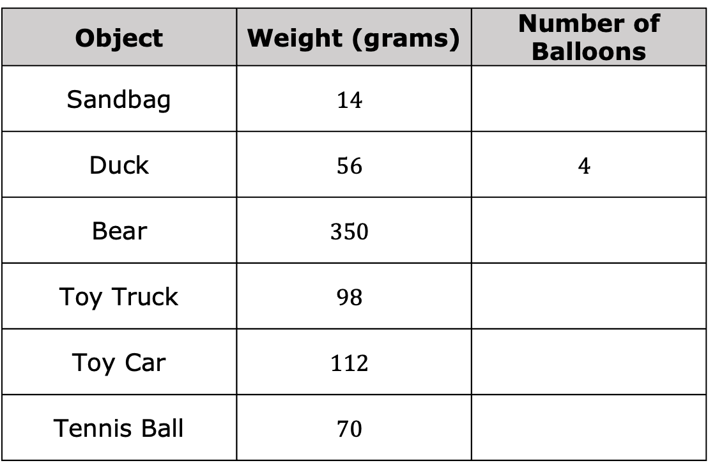
Complete the table for the number of balloons needed to float each object based on its weight.
Object | Weight (grams) | Number of Balloons
Sandbag | $$14$$
Duck | $$56$$ | $$4$$
Bear | $$350$$
Toy Truck | $$98$$
Toy Car | $$112$$
Tennis Ball | $$70$$
volume 1, pg. 190

Slide 13
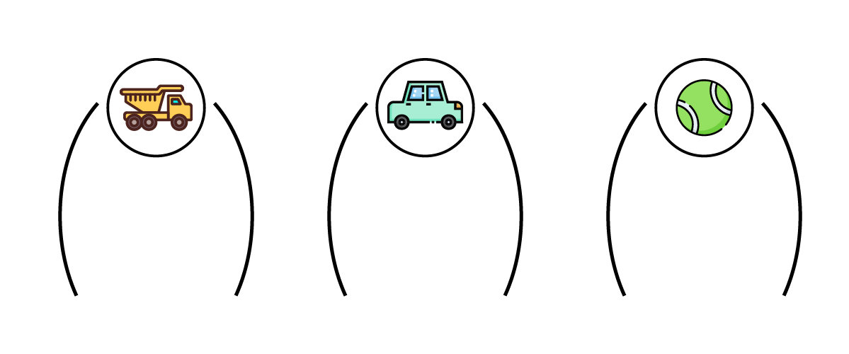

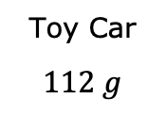

Draw the balloons for each object that would make it float.
Toy Truck
$$98 g$$
Toy Car
$$112 g$$
Tennis Ball
$$70 g$$
volume 1, pg. 190

Slide 14

Guided Practice
volume 1, pg. 190

Slide 15

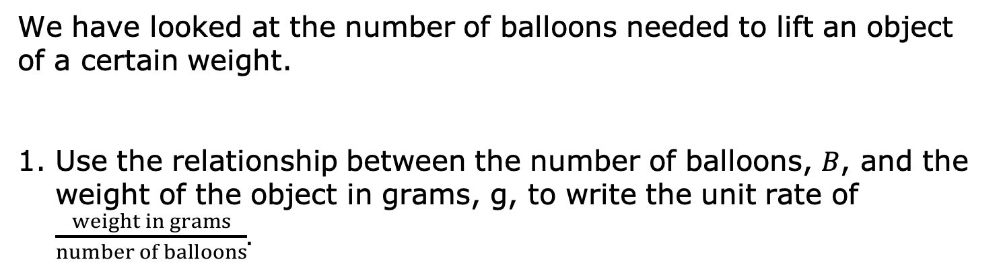
5.4.3 Guided Practice: Exploring Equivalent Ratios Using Tables
We have looked at the number of balloons needed to lift an object of a certain weight.
Use the relationship between the number of balloons, $B$, and the weight of the object in grams, g, to write the unit rate of $\frac{weight in grams}{number of balloons}$.
volume 1, pg. 190

Slide 16
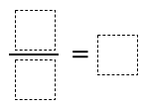
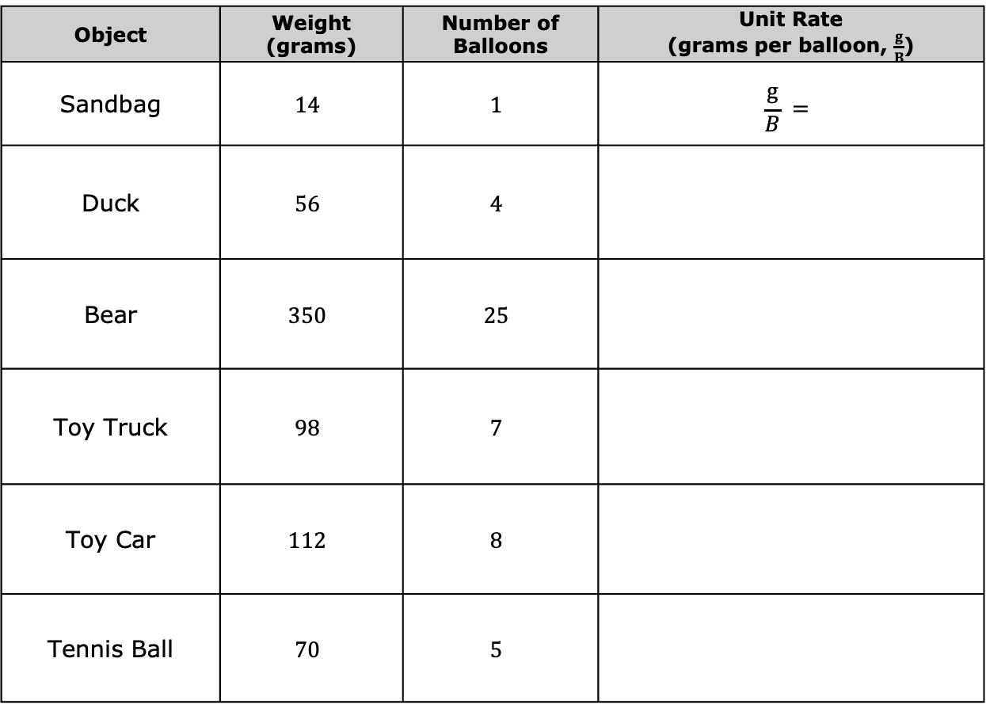
Complete the table to show the unit weight lifted by a balloon.
Object | Weight (grams) | Number of Balloons | Unit Rate (grams per balloon, $\frac{g}{B}$)
Sandbag | $$14$$ | $$1$$ | $$\frac{g}{B} =$$
Duck | $$56$$ | $$4$$
Bear | $$350$$ | $$25$$
Toy Truck | $$98$$ | $$7$$
Toy Car | $$112$$ | $$8$$
Tennis Ball | $$70$$ | $$5$$
volume 1, pg. 190

Slide 17
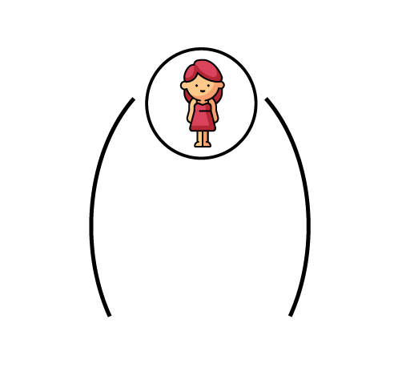
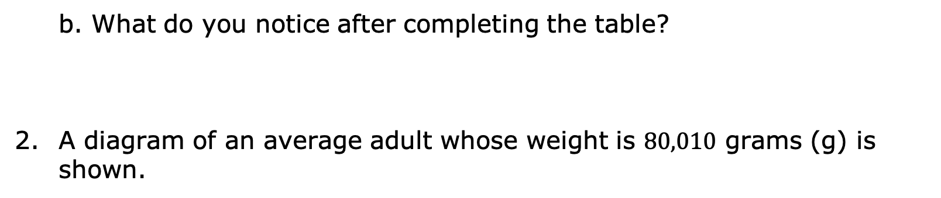

What do you notice after completing the table?
A diagram of an average adult whose weight is $80,010$ grams (g) is shown.
Discuss with your partner how to use the information from the previous table to determine how many balloons it would take to float the person.
Average Adult
$$80,010 g$$
Complete the statement.
It would take _________ balloons to float the person.
volume 1, pg. 191

Slide 18
Weather balloons would be better to use in this situation. Unlike regular balloons, weather balloons are designed to lift heavier objects.
The partially completed table shows the weight in pounds (lbs) of four objects and the number of weather balloons needed to float each object.
volume 1, pg. 191

Slide 19
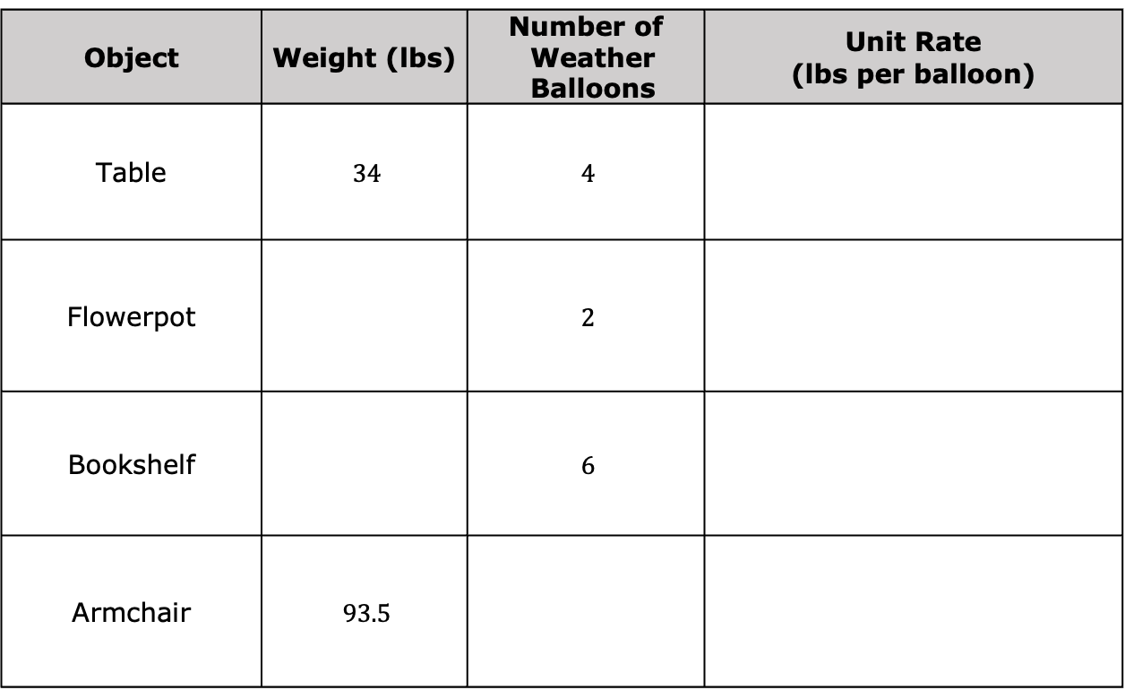
Complete the table with the weight, the number of weather balloons, and unit rate for each object.
Object | Weight (lbs) | Number of Weather Balloons | Unit Rate (lbs per balloon)
Table | $$34$$ | $$4$$
Flowerpot |  | $$2$$
Bookshelf |  | $$6$$
Armchair | $$93.5$$
volume 1, pg. 191

Slide 20
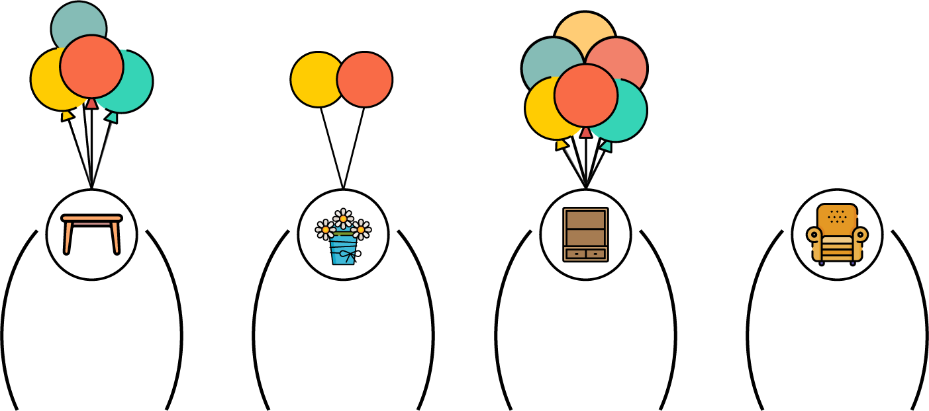


Draw the weather balloons needed to make the chair float and write the weight of each object determined from the table.
Table
$34$ lbs.
Flowerpot
_____ lbs.
Bookshelf
_____ lbs.
Chair
$93.5$ lbs.
volume 1, pg. 192

Slide 21
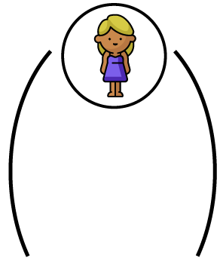
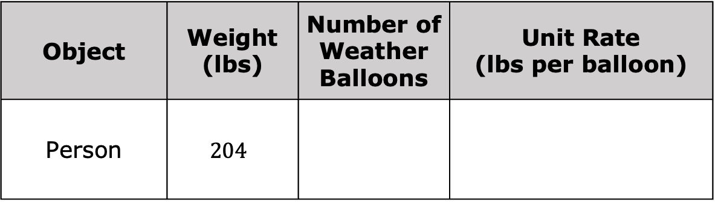
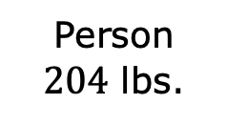
Consider the figure shown.
Person
$204$ lbs.
How many weather balloons would it take to float the person? Write your answer in the table.
Object | Weight (lbs) | Number of Weather Balloons | Unit Rate (lbs per balloon)
Person | $$204$$
volume 1, pg. 192

Slide 22

Wrap-Up
volume 1, pg. 192

Slide 23
5.4.4 Wrap-Up: Cool Down
Your friend wants to know how to calculate the number of balloons she would need to float.
Answer the questions in the space provided in the table.
What information do you need to know?
What instructions would you give her about how to calculate the number of balloons she would need to float?
volume 1, pg. 192

